Slide 1
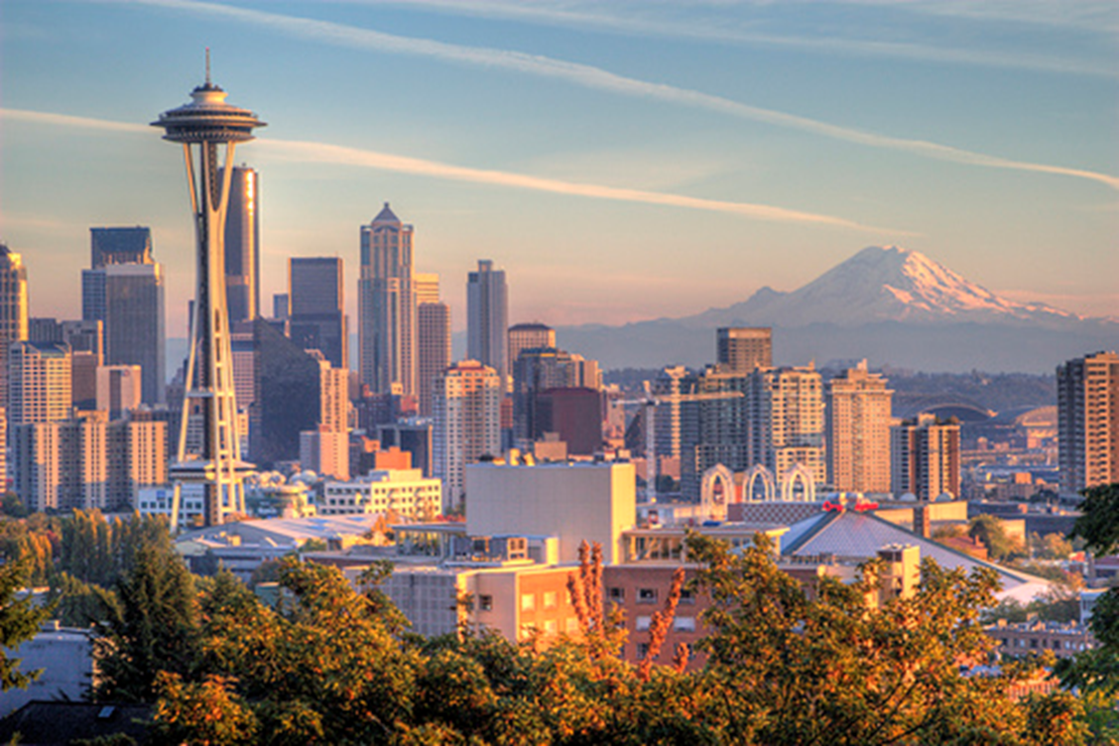
KING COUNTY HOUSING ANALYSIS
PRESENTED BY:
BADER ALBULAYHIS, BRANDON HALL,
SURBHI JOSHI, YOGITA SINGH, JENA ZANGS
SEIS 763 – Machine Learning & Deep Learning

Slide 2
Agenda
Project Overview & Objectives
Data Overview
Our Models
Outcome
Challenges Encountered
Conclusion
Questions

Slide 3
Project Overview & Objectives
Project Overview & Objective is to find a dataset to practice our skills and knowledge obtained through the duration of Machine & Deep Learning.
Such as: Linear Regression Models, SVM Models and Neural Network Models.
We selected a Housing dataset from Kaggle.
Our Goal was to identify the predictors which have the most influence on the housing data price (Y)for this particular area. Specifically addressing the recent record setting housing prices within King County

Slide 4
Data Overview
Our Data set consisted of the following attributes:
ID: Unique identifier for the house that was sold.
Date: Date the house was sold on.
Price: The monetary price the home was sold for.
Bedrooms: Total number of bedrooms within the house.
Bathrooms: Total number of bathrooms within the house.
1.0 = Full, include bath
0.75 = Partial, includes shower
0.50 = Half, does not include bath or shower
Sqft_living: Total amount of livable square footage within the house.
Sqft_lot: Total square footage of the land the house sits upon.
Floors: Total number of floors/stories the house includes.
Waterfront: Is this house/land a waterfront property.
View: Does the house/land have a noteworthy view of the area(water, city, valley, etc.)
Condition: Scale of 1 to 5 on the overall condition of the house that sold
1 = need a complete remodel
5 = move-in-ready
Grade: The amount of slope that is near a house for water run-off.
1-13 range
Sqft_above: Total amount of livable square footage above ground level and the foundation on record
Sqft_basement: If applicable, the total livable square footage below ground level
Yr_Built: Year the house was built.
Yr_Renovated: If applicable, the most recent year the house has been renovated.
Zipcode: The zipcode for the address of the house.
Lat: Latitude of the geo-location for the house.
Long: Longitude of the geo-location for the house.
Sqft_Living15: Actual total livable square footage of house sold

Slide 5
Linear Regression Model
Data prep work:
Remove unrealistic data (entire rows) with zero or no values
Remove predictors that may cause data leakage
Identify categorical variables - Dummy variables
Standardize all other variables

Slide 6
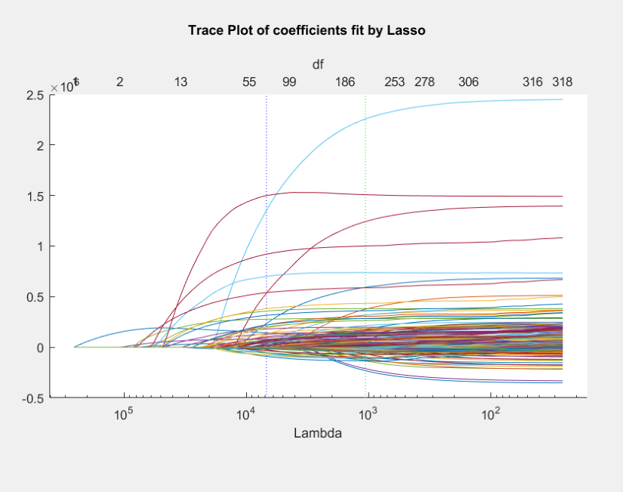
Linear Regression Continued
Fitlm
Lasso preformed
First Model:
R-squared: 0.847
Adjusted R-squared: 0.845
MSE: 20942940057.3651
F-statistic vs. constant model: 367, p-value = 0
Total Predictors: 321

Slide 7
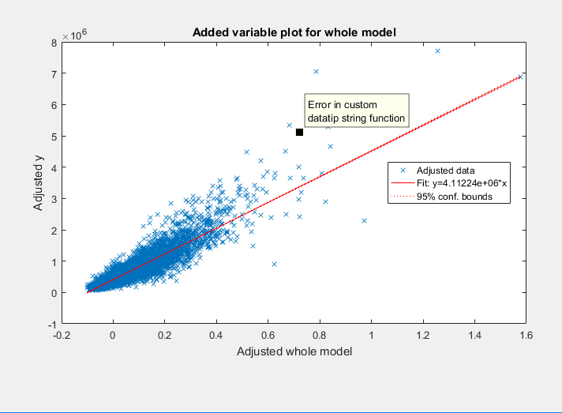
Linear Regression Continued
This is the plot for the original model

Slide 8
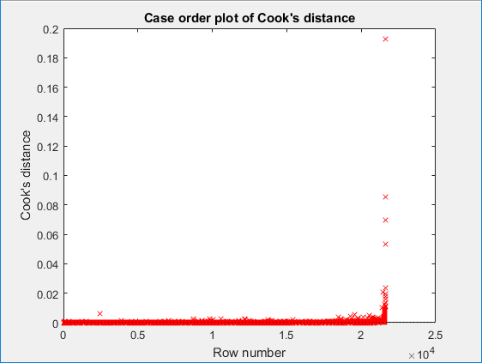
Linear Regression Continued
Remove outliers
Cooks Plot Visual
Cooks distance + Leverage
5 times the average
potential_outlier=find((md1.Diagnostics.CooksDistance+md1.Diagnostics.Leverage)>5*mean(md1.Diagnostics.CooksDistance+md1.Diagnostics.Leverage));
Identified 251 outliers

Slide 9
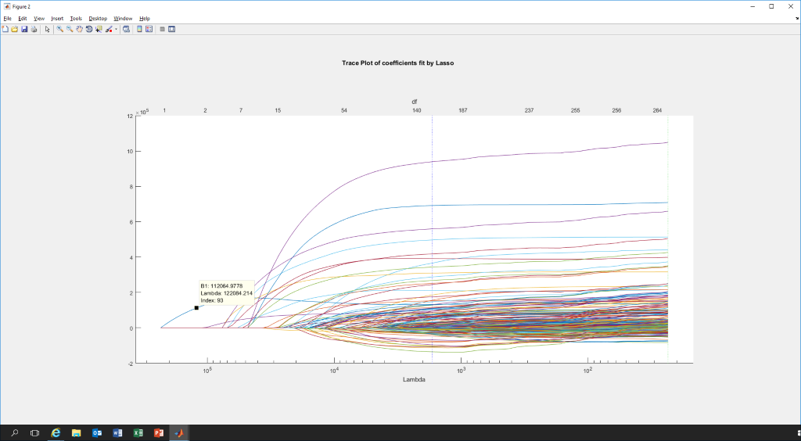
Linear Regression Continued
Updated Model after Outlier Removal
Updated Lasso
R-squared: 0.845
Adjusted R-squared: 0.843
MSE: 18180765433.3296
Total Predictors: 266 (decreased)
Removing of some of the rows caused some of the dummy attributes to be removed causing less total attributes
Note: Zscore was completed again prior to generating the new model

Slide 10
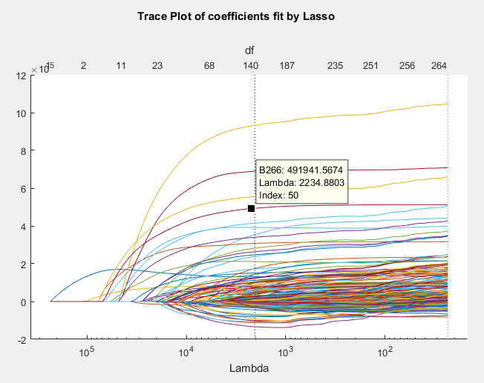
Linear Regression Continued
Final Model
Lasso with Index chosen
Created using Lasso
We were able to eliminate 126 predictors by selecting the lambda value of 2234.8803 at index 50. This simplified the model while maintaining similar prediction quality
Number of observations: 21348, Error degrees of freedom: 21207 Root Mean Squared Error: 1.35e+05 R-squared: 0.843, Adjusted R-Squared 0.841 F-statistic vs. constant model: 810, p-value = 0
MSE= 1.835855927696520e+10
Total Predictors: 140

Slide 11
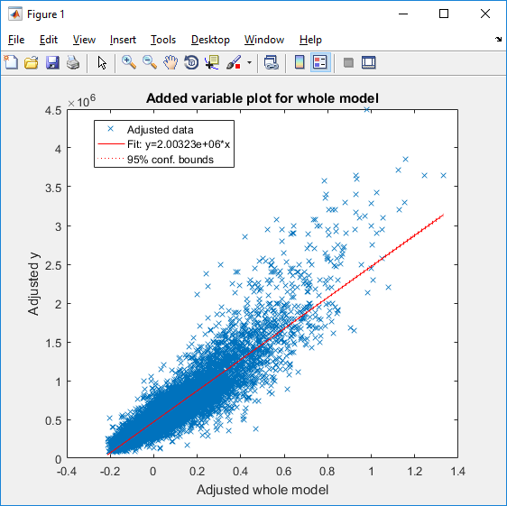
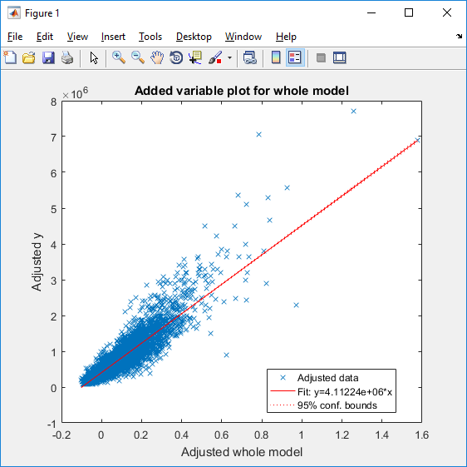
Linear Regression Final model vs Original
md10
md2

Slide 12
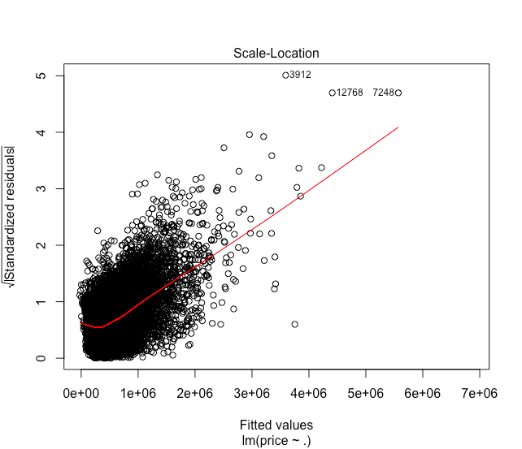
Linear Regression using R
Summary of first model :
R-squared: 0.8475
Adjusted R-squared: 0.8452
Number of predictors : 321

Slide 13
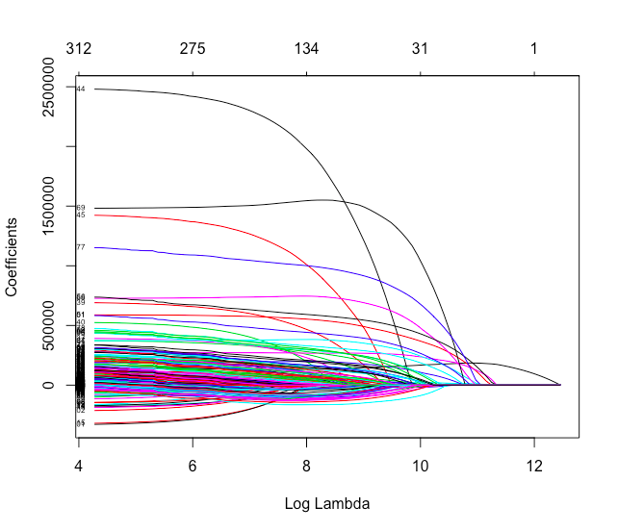
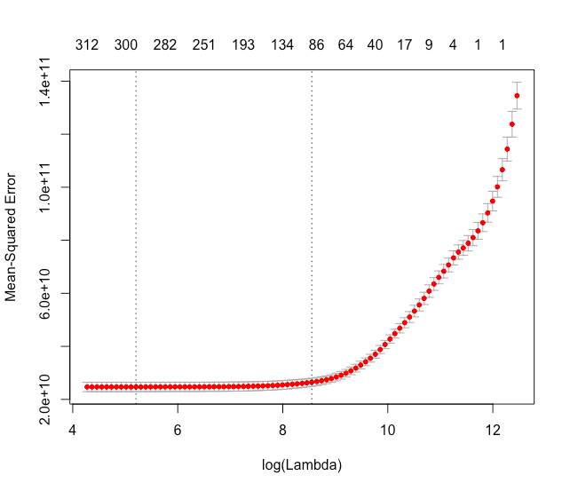
Linear Regression using R
Important attributes :
1- sqft_living
2- ZipCode
3- House view

Slide 14
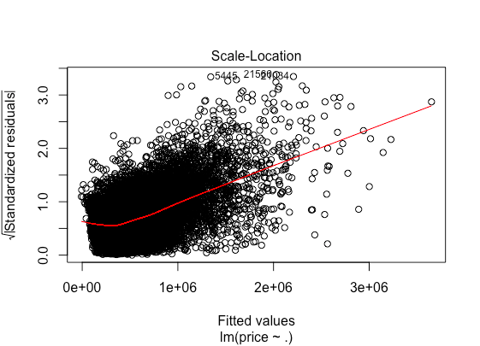
Linear Regression using R
The second Model :
Lambda = 4721
Number of predictors : 98
Eliminating 223 attributes
R-squared: 0.8277
Adjusted R-squared: 0.8270

Slide 15
SVM Model
Linear Regression model gave us 140 predictors for lambda value of 2234.8803 at index 50.
Extracted these variable from the data :
Took the X variable which had all Zscored values for the continuous variables
Took the X variable which had all the dummy variables for categorical predictors
Concatenated them together and exracted those 140 variables from there.
Price’s labels:
0: Less than 321950
1: Greater than equal to 321950 & less than 450000
2: Greater than equal to 450000 & & less than 645000
3: Greater than equal to 645000
We divided the categories in a balanced manner using the three quartiles and median and thus chose accuracy to be the indicator of a good model.

Slide 16
SVM Model Continued…
We started with a multi-class SVM model with 10-fold Cross Validation.
Built different models without Kernel function and then with it, with different box constraints to see their impact on accuracy.
We then ran the kfoldLoss for each of the 10 models generated and checked for the accuracy of the one of 10, which had the least loss.

Slide 17
SVM Model Continued…
Calculated the accuracy by plotting a Confusion Matrix for Target Class vs Output Class
We also used different combinations to build our models to see what impact they make on the accuracy of our model.

Slide 18
SVM Model Continued…
Kernel Function | Box Constraint, C | Accuracy
None | None | 65.9%
Gaussian | None | 83.1%
Gaussian | 0.000001 | 58%
Gaussian | 1 | 83.1%
Gaussian | 2.5 | 86%
Gaussian | 3 | 86.7%
Gaussian | 3.5 | 87.4%
Gaussian | 4 | 87.4%
Gaussian | 4.5 | 87.4%
Gaussian | 5 | 88%
Gaussian | 10 | 89.2%
Gaussian | 25 | 90.8%
None | 25 | 66.5%

Slide 19
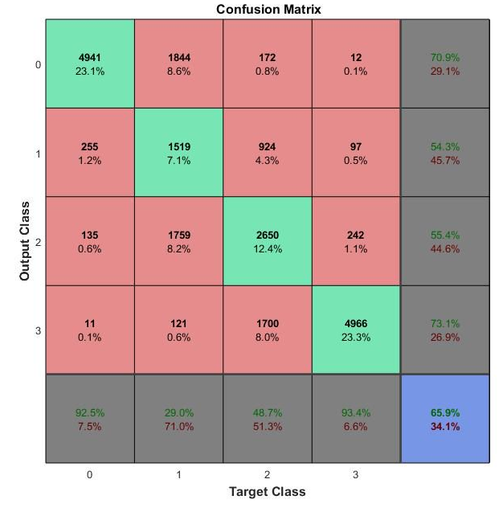
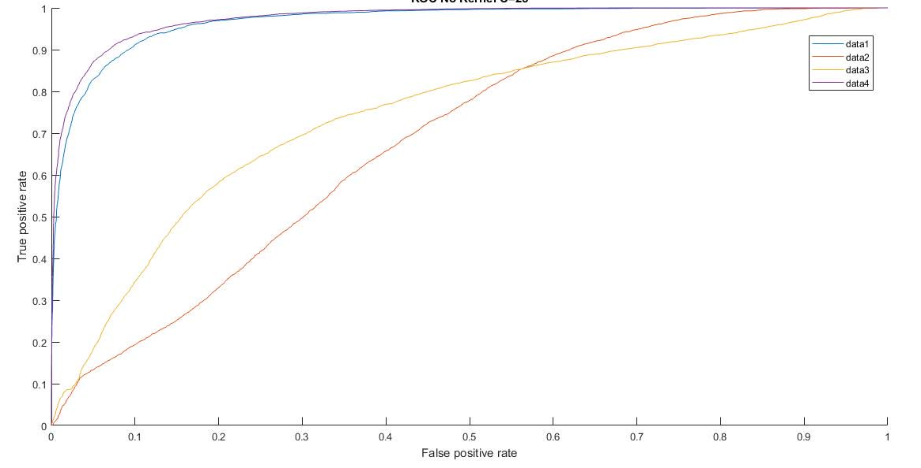
SVM Model Continued…

Slide 20
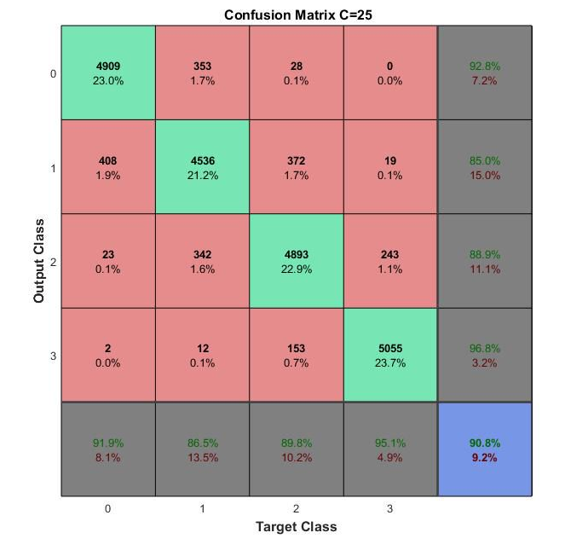
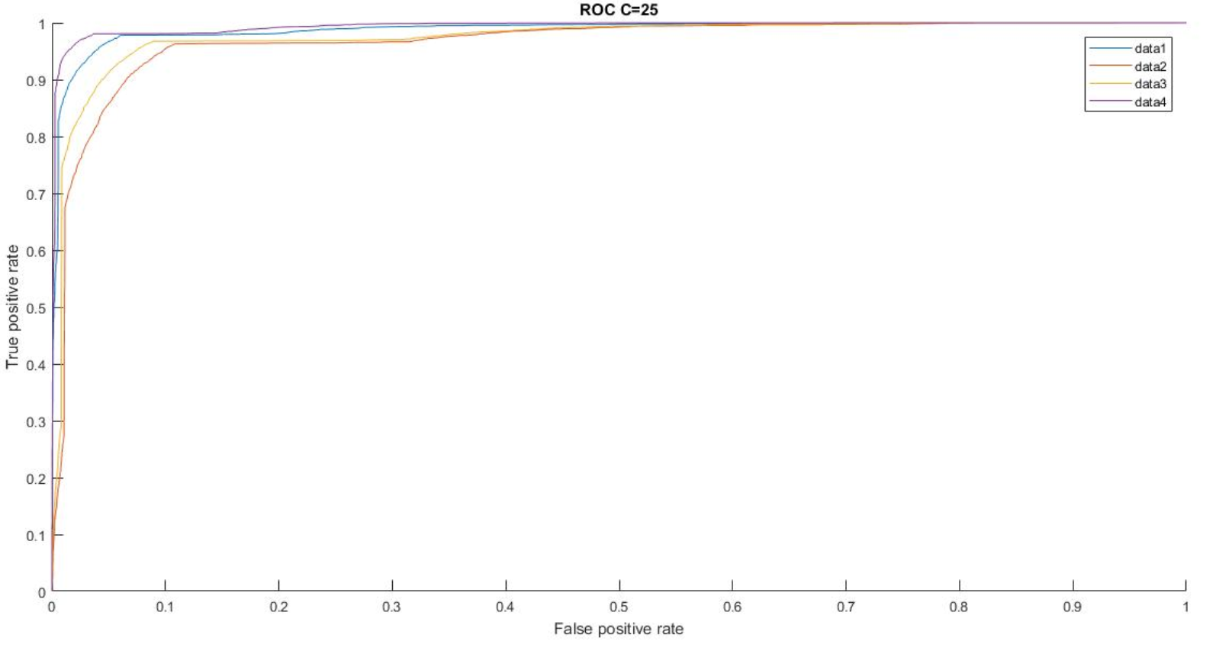
SVM Model Continued…

Slide 21
SVM Model Continued… Challenges faced..
SVM takes time!
Matlab is machine dependent

Slide 22
Neural Network - Pattern Recognition
Utilized base dataset with all predictors, outliers removed.
85% training, 15% testing
Price’s labels:
0: Less than 321950;
1: Greater than equal to 321950 & less than 450000;
2: Greater than equal to 450000 & & less than 645000;
3: Greater than equal to 645000;
Tested and built networks with various parameters settings to increase accuracy.
Adjusted layers and neurons to increase accuracy.
Tested out variety to price ranges (4, 5, 6, 10) to see if range of price had effect on accuracy.
Better Precision and Recall for 0 and 3rd categories than 1st and 2nd.

Slide 23
Pattern Recognition NN Continued…
Total Layers | Total Neurons (each layer) | Accuracy
1 | 100 | 56.3%
1 | 50 | 60.1%
1 | 10 | 60.9%
1 | 5 | 67.2%
2 | 100 50 | 59.9%
2 | 10 5 | 69.3%
2 | 5 3 | 74.4%
2 | 6 3 | 70.1%
3 | 100 50 25 | 58.2%
3 | 50 25 10 | 63.5%
3 | 10 5 2 | 68.4%
3 | 5 3 2 | 70.3%
4 | 100 50 75 25 | 62.2%
4 | 10 5 3 2 | 69.8%

Slide 24
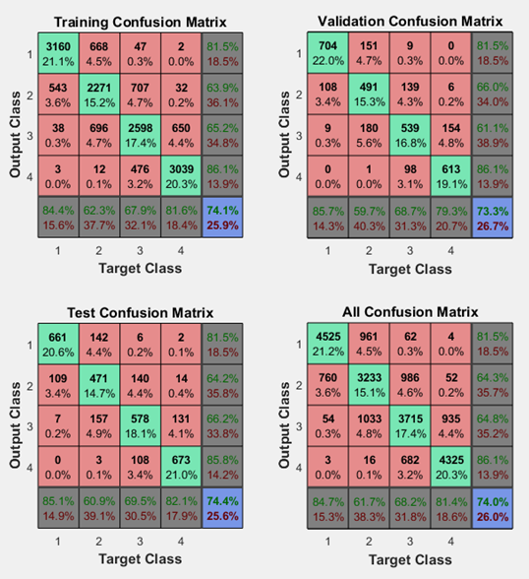
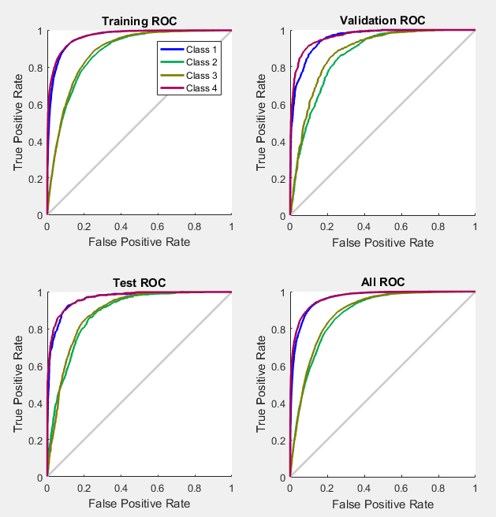
Pattern Recognition NN Continued…

Slide 25
Neural Network – AutoEncoder
Utilized base dataset with all predictors, outliers removed.
90% training, 10% testing
Price’s labels:
0: Less than 321950;
1: Greater than equal to 321950 & less than 450000;
2: Greater than equal to 450000 & & less than 645000;
3: Greater than equal to 645000;
Initially tested Autoencoder with all price dummy variables.
Adjusted layers and neurons to increase accuracy.
Varied Max Epochs throughout different layers and sparsity proportion to increase accruacy.

Slide 26
AutoEncoder NN Continued…
Total Layers | Total Neurons (each layer) | Deepnet Accuracy | Fine Tuning Accuracy
1 | 100 | 43.2% | 56.8%
1 | 50 | 48.6% | 59.2%
1 | 10 | 55.4% | 64.4%
1 | 5 | 56.6% | 65.7%
2 | 200 100 | 55.5% | 67.4%
2 | 100 50 | 68.3% | 70.0%
2 | 25 10 | 65.8% | 69.8%
2 | 5 2 | 64.2% | 67.7%
3 | 200 100 50 | 44.5% | 70.2%
3 | 100 50 25 | 68.6% | 76.0%
3 | 50 25 10 | 61.7% | 69.8%
3 | 10 5 2 | 60.0% | 66.3%
4 | 200 200 100 50 | 36.2% | 56.8%
4 | 10 5 3 2 | 41.1% | 54.3%

Slide 27
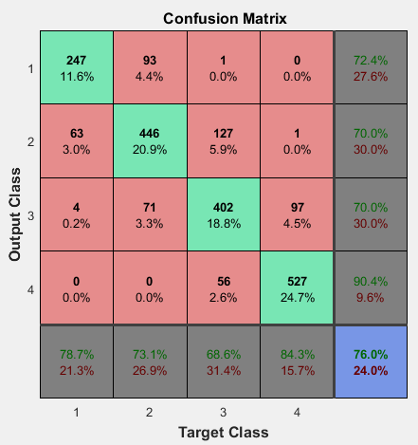
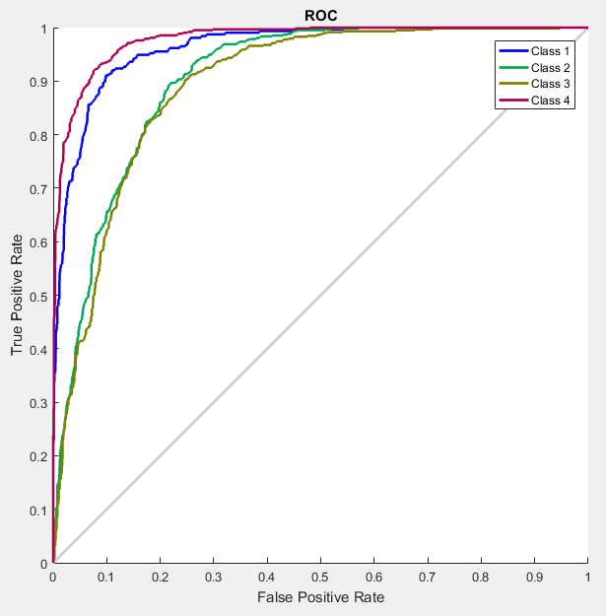
AutoEncoder NN Continued…

Slide 28
Challenges Encountered
Generating ideas.
Approaches
Identifying Datasets
Timing Constraints
Technology issues
Team coordination

Slide 29
Conclusion
Assembling a base dataset in which all members of the team agree on is critical when working on any project.
Our SVM model produced the best model to predict housing price range for our Kings County Dataset and would be recommended, at this stage, to use moving forward with any further analysis.
With the inclusion of more up-todate data we may be able to change the ranges of prices to increase accuracy of models and narrow in on prices.
Taking this project to the next step would including introducing more predictors, such as school districts, walkability score, crime data as well as introducing noise into our data for better learning performance.

Slide 30
Questions or Comments?

